Slide 1


SRI RAMAKRISHNA INSTITUTE OF TECHNOLOGY, COIMBATORE-10 (An Autonomous Institution) (Educational Service: SNR Sons Charitable Trust) (Accredited by NAAC with ‘A’ Grade & NBA) (Approved by AICTE, New Delhi and permanently Affiliated to Anna University, Chennai) Department of ECE
INTEGRATED DESIGN PROJECT
Smart Intrusion detection system for Crop protection Using ESP32
Akshaya K.V [71381904004]
Kayalvizhe J [71381904030]
Mirdulaa A [71381904034]
Project Supervisor: Dr.G.SEKAR
Assistant Professor (Senior Grade), Dept of ECE
Date:15/11/2022

Slide 2
LIST OF CONTENTS
Introduction
Objective
Literature Survey
Existing Methodology
Proposed Methodology
Conclusion
Gantt Chart
Simulation
Result
Reference

Slide 3
INTRODUCTION
In most countries, agriculture plays a significant role in the country's economy. Farming is the fundamental bone of the
country’s improvement.
Owing to overpopulation, deforestation results in fruits and water shortages in woodlands. Therefore, the obstruction
of animals in local areas grows day by day, disrupting human life and land, creating human creature confrontation, but
every living species on this planet has substantial eco- framework function according to the norm of nature.
Therefore, in homestead areas, the structure for animal position is vital.

Slide 4
OBJECTIVE
To design a secure system for safeguarding the farmlands by preventing the ingress of animal or humans in the
farm.
To prevent animals from destroying crops.

Slide 5
LITERATURE SURVEY
S.NO | TITLE | AUTHOR NAME | TECHNIQUE USED
1 | Smart Intrusion Detection System for Crop Protection by using Arduino . | Srushti Yadahalli, Aditi Parmar, Prof. Amol Deshpande. | Arduino UNO,Sensors & GSM.
2 | Crop protection and its effectiveness against wildlife: A case study of two villages of shivapuri national park, nepal | S. Pandey and S. B. Bajracharya. | Bio fencing, Trenches.
3 | Crop damage and livestock depredation by wildlife:a case study from nanda devi bio- sphere reserve, India. | K. Rao, R. Maikhuri, S. Nautiyal, and K. G. Saxena | Paired plot Technique

Slide 6
CONTD.,
S.NO | TITLE | AUTHOR NAME | TECHNIQUE USED
4 | Development of embedded based system to monitor elephant intrusion in forest border areas using internet of things. | R. Vigneshwar and R. Maheswari | Using Internet of Things(IOT).
5 | Intrusion detection through image processing and getting notified via SMS and image | R. Bhardwaj, K. Bera, O. Jadhav, P. Gaikwad, and T. Gupta | Image Processing
6 | Proposed noval security system based on passive infrared sensor | A. Chaturvedi, P. Kumar, and S. Rawat | Passive Infrared Sensor
7 | Study on an agricultural environment monitoring server system using wireless sensor networks | J. Hwang, C. Shin, and H. Yoe | Wireless Sensor Networks(WAN)

Slide 7
EXISTING METHODOLOGY
The existing system primarily provides surveillance functionality. In addition to this, these systems do not
come with the assurance of acting as a barrier between the farm and wild animals, especially in these areas
of application.
The existing systems also need to take into consideration the fact that not all animals have the same size
and based on the threat level imposed by the animal trespassing the farmland different measures are to be
undertaken to prevent the entry of animals in the area.
Many crop monitoring systems exist but rarely do they help in intrusion detection.
Also the most commonly followed way to protect the crops from the animals is the set up a electric fence
surrounding the farm lands. That is not effective when there is no electricity and sometimes it may harm the
animals.
So this proposal looks forward in eliminating these limitations.

Slide 8
PROPOSED METHODOLOGY
Block Diagram
Power Supply Unit
ESP32e
PIR Sensor
ADC
Buzzer
ESP32
IOT based Communication Module
Ultrasonic Sensor
ADC

Slide 9
PROPOSED METHODOLOGY
Flow Chart
INTRUDER
I/P
PIR Sensor
Sensor turns ON
Ultrasonic Sensor
Sensor turns ON
ESP32
Receives Alerts
Buzzer
Buzzer sound with Alert Messages
Farmers
O/P

Slide 10
PROPOSED METHODOLOGY
When the intruder passes, the PIR sensor turns on detecting the motion of the object. The
ultrasonic sensor is used to detect the distance of the object. ESP32 Microcontroller is used
for processing and alarm and message is sent to the farmers.
The Alert is sent to the farmer if any intruder is detected, through IOT gateway using blynk app.
The intensity of the buzzer varies according to the distance of approach of intruder so that the
farmers get to know the level of emergency.

Slide 11
CONCLUSION
Agriculture is still one of the most crucial sectors of the Indian economy. It is important for human
survival as well as economic growth. Traditional systems like humanoid scarecrows are used even
today in an agricultural field to stop birds and animals from disturbing and feeding on growing crops.
There are many loopholes in such ideas and so enhancing agricultural security has become a major
issue these days.
Thus, this project focuses on proposing a system which detects the intruders, monitors any malicious
activity and then reports it to the owner of the system.
It acts as an adaptable system which provides a practicable system to the farmers for ensuring
complete safety of their farmlands from any attacks or trespassing activities.

Slide 12
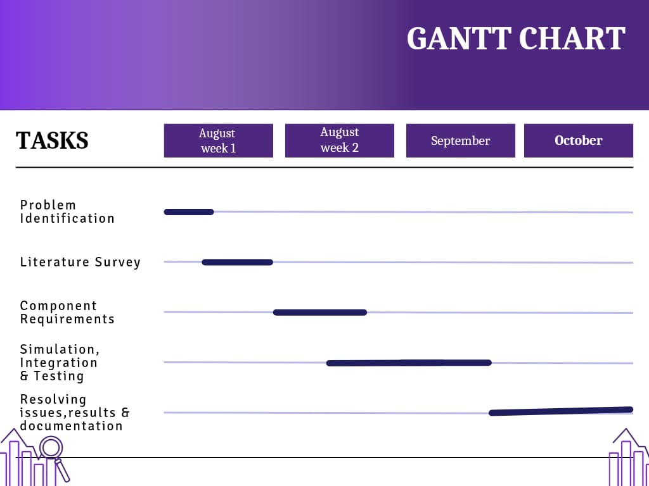
GANTT CHART

Slide 13
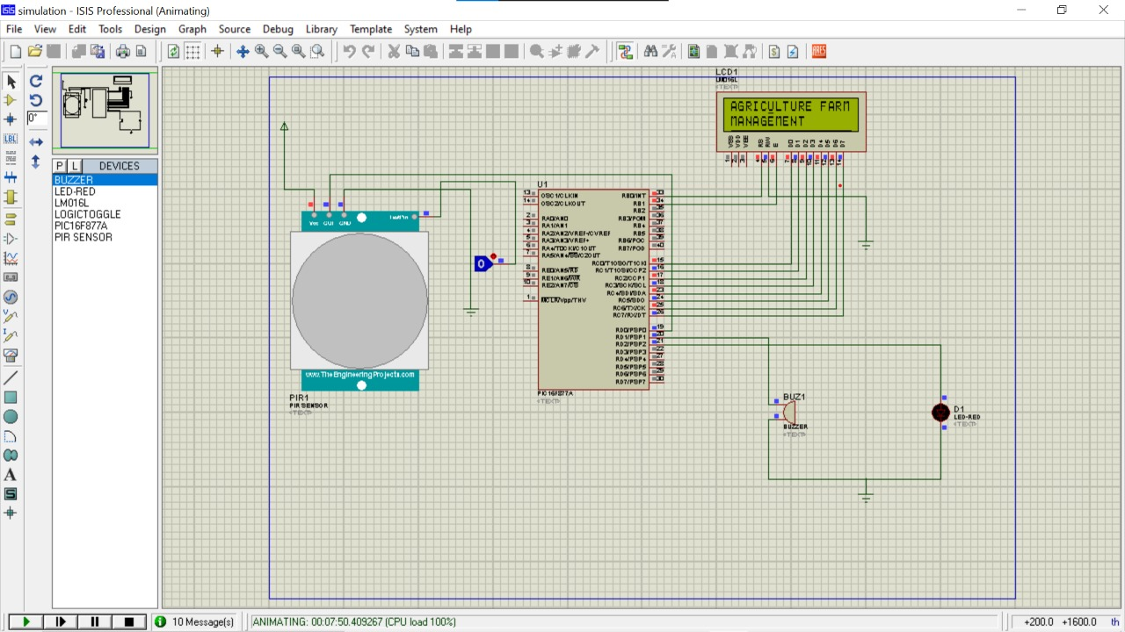
SIMULATION

Slide 14
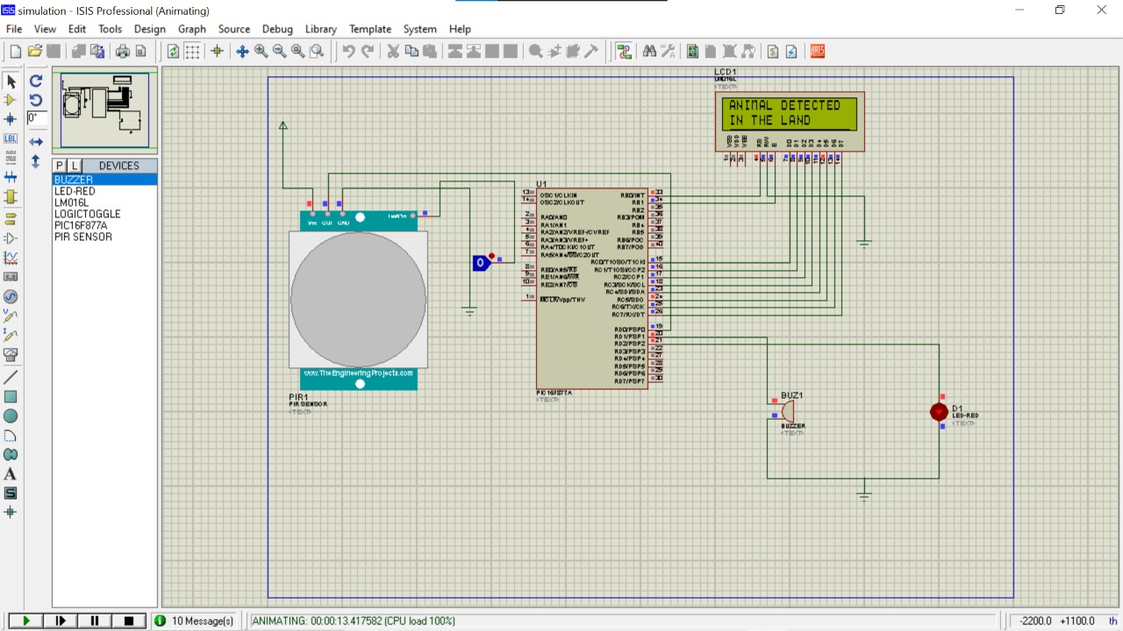
SIMULATION

Slide 15
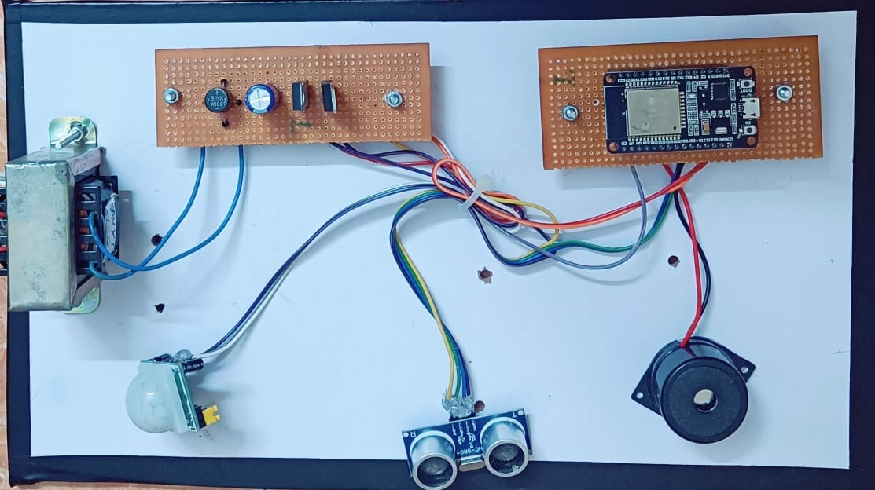
RESULT:
HARDWARE PROTOTYPE MODEL
Power Supply Unit
ESP32
Transformer Unit
Buzzer
PIR Sensor
Ultrasonic sensor

Slide 16
HARDWARE PROTOTYPE OUTPUT
SENSOR | SENSOR ON – OUTPUT (DISPLAY MESSAGE) | SENSOR OFF– OUTPUT (DISPLAY MESSAGE)
Ultrasonic Sensor | Object Identified | Everything normal in land
PIR Sensor | Animal Detected | Everything normal in land

Slide 17
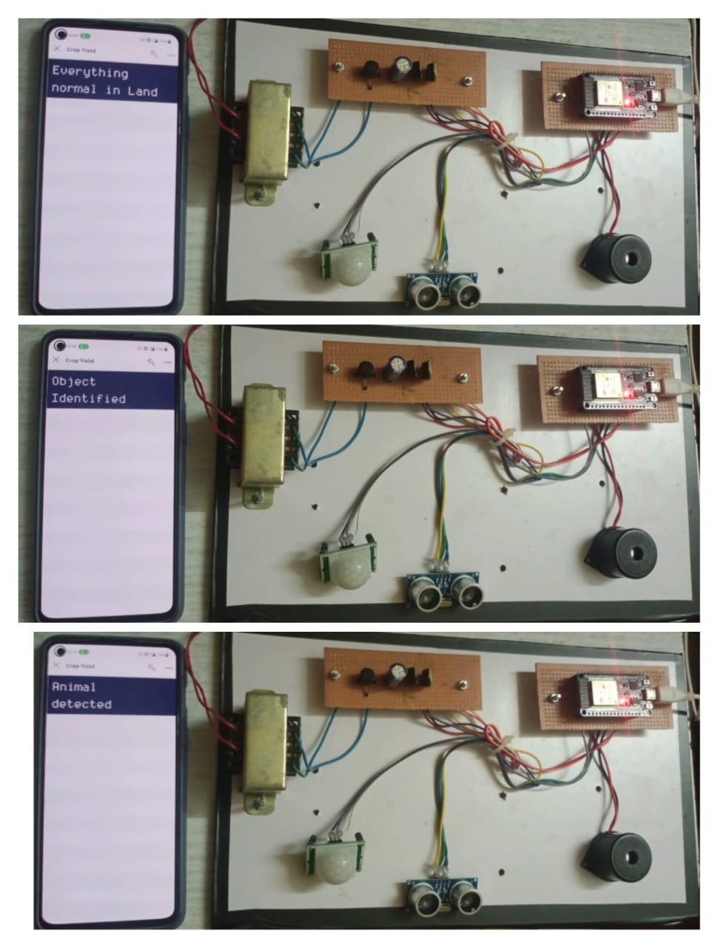
IMPLEMENTATIONS AND RESULTS OF HARDWARE PROTOTYPE

Slide 18
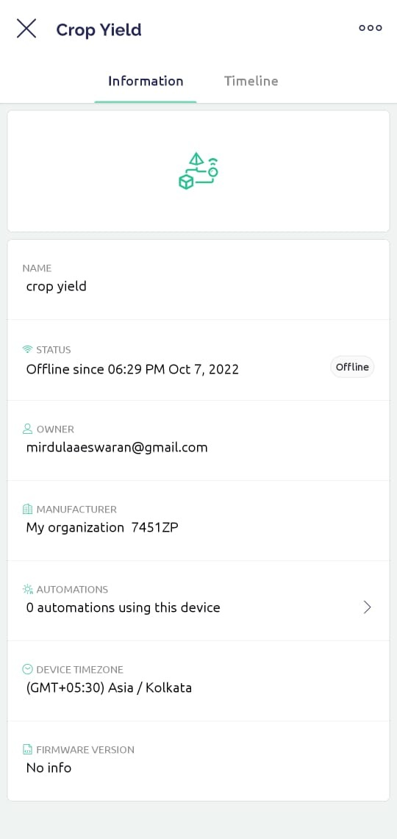
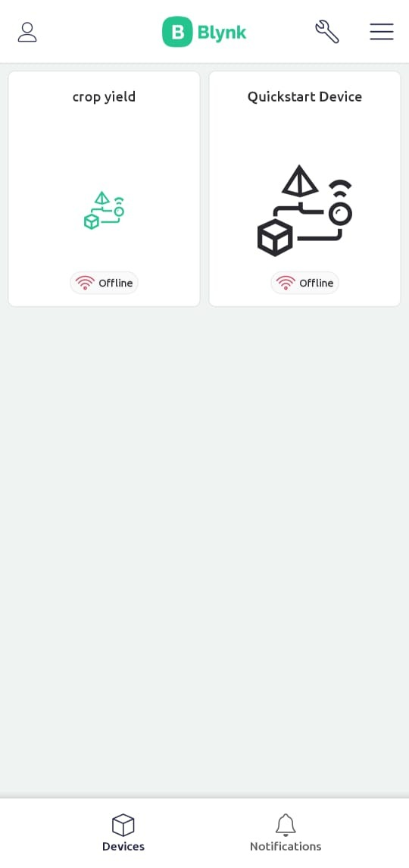
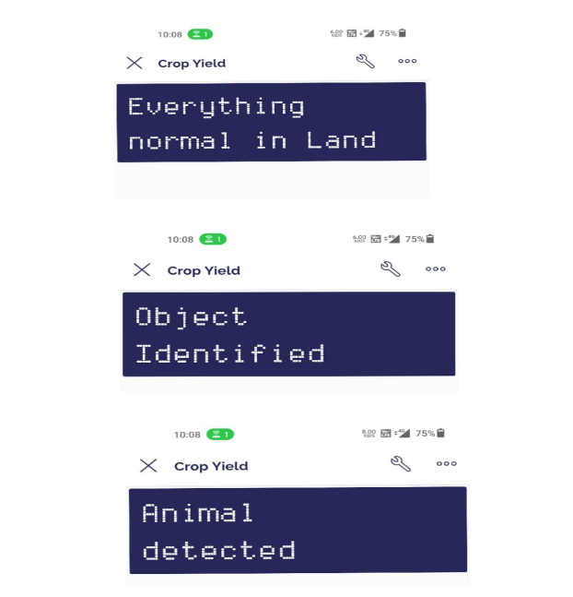
SOFTWARE IMPLEMENTATION

Slide 19
REFERENCE
[1] Srushti Yadahalli,Aditi Parmar,Prof.Amol Despande, “Smart Intrusion Detection System for Crop Protection by using
Arduino,” Proceedings of the Second International Conference on Inventive Research in Computing
Applications(ICIRCA 2020)
[2] S. Pandey and S. B. Bajracharya, “Crop protection and its effectiveness against wildlife: A case study of
two villages of shivapuri national park, nepal,” Nepal Journal of Science and Technology, vol. 16, no. 1,
pp.1–10, 2015.
[3] K. Rao, R. Maikhuri, S. Nautiyal, and K. G. Saxena, “Crop damage and livestock depredation by wildlife:
a case study from nanda devi bio- sphere reserve, india,” Journal of Environmental Management, vol. 66,
no. 3, pp. 317–327, 2002.
[4] V. Bavane, A. Raut, S. Sonune, A. Bawane, and P. Jawandhiya, “Protection of crops from wild animals
using intelligent surveillance system.”
[5] R. Vigneshwar and R. Maheswari, “Development of embedded based system to monitor elephant
intrusion in forest border areas using internet of things,” International Journal of Engineering Research,
vol. 5, no. 7, pp. 594–598, 2016.

Slide 20
CONTD.,
[6] R. Bhardwaj, K. Bera, O. Jadhav, P. Gaikwad, and T. Gupta, “Intrusion detection through image
processing and getting notified via sms and image,” 2018.
[7] R. M. Antunes and F. L. Grilo, “Intruder alarm systems-the road ahead,” in Advanced Technologies.
IntechOpen, 2009.
[8] J. Hwang, C. Shin, and H. Yoe, “Study on an agricultural environment monitoring server system
using wireless sensor networks,” Sensors, vol. 10, no. 12, pp. 11 189–11 211, 2010.
[9] R. Edirisinghe, D. Dias, R. Chandrasekara, L. Wijesinghe, P. Siriwar-dena, and P. K. Sampath,
“Wi-alert: a wireless sensor network based intrusion alert prototype for hec,” International Journal
. Of Distributed and Parallel Systems, vol. 4, no. 4, p. 23, 2013.
[10] R. R. Ragade, “Embedded home surveillance system wit h pyroelectric infrared sensor using gsm,”
in 2017 1st International Conference on Intelligent Systems and Information Management(ICISIM).
IEEE, 2017, pp. 321–324.

Slide 21
CONTD.,
[11] P. S. Dhake and S. S. Borde, “Embedded surveillance system using pir sensor,” International
Journal of Advanced Technology in Engineering and Science, www. ijates. com Volume, no. 02,
2014.
[12] A. Chaturvedi, P. Kumar, and S. Rawat, “Proposed noval security system based on passive
infrared sensor,” in 2016 International Conference on Information Technology (InCITe)-The
Next Generation IT Summit on the Theme-Internet of Things: Connect your Worlds. IEEE,
2016, pp. 44–47.
[13] B. Jayanthi and D. Prabakaran, “Border security system using sensor interface.”
[14] D. KARTHIK and R. R. BABU, “Smart crop protection system with image capture over iot.”
[15]
P.Munaswamy, Smart agriculture system using iot technology, international journal of recent technology and engineering,ISSN:2277-3878,volume 7,issue-5,jan 2019.

